Slide 1
Analysis of CFPB’s Consumer Complaints Dataset
Group members:
Pal Doshi
Rajat Aghi
Akash Udani
Khushal Navani

Slide 2
DATASET DESCRIPTION

Slide 3
The Dataset
DESCRIPTION
Our data set contains the list of consumer complaints received by the Consumer Finance Protection Bureau (CFPB) about financial product services offered by banks and other financial institutions across the United States.
The data set contains complaints received by the CFPB from December 2011 till April 2017.
SOURCE AND LICENSING
The data set was retrieved from the data.gov website.
There is no license associated with the data set and its intended for public access and use.
Notes:
Option: say all this in intro and remove this slide?

Slide 4
769,195 Complaints
18 Parameters
5 Years
Total Rows
Total Columns
Time Period
Notes:
Any suggestions for the 3rd bullet?

Slide 5
Additional Dataset:
For our research question where we predict number of complaints based on financial assets of an institution:
The financial assets data was split in multiple files, a separate file was provided for each quarter of every year from 2011-2015. We collated all data into one document.
We mapped consumer complaints data from the consumer complaints data set to the financial data. Only institutions common to both data sets were considered.
Since the consumer complaints data is date wise, we aggregated the data to represent quarter wise values for each year.
#rows = 14

Slide 6
DATA CLEANING

Slide 7
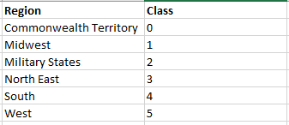
Apart from the basic cleaning script which formats the data, we did additional data cleaning along the following lines:
We aggregated the cities and identified them by 6 regions – Commonwealth Territory, Military States, North,-East, South, West, Midwest
For ease of clustering analysis, we mapped the various textual levels to numerical factors for all required columns
For example, we mapped Region as shown below:

Slide 8
682,949 Complaints
7 Parameters
Product : 12 Levels
Issue : 95 Levels
Region : 6 Levels
Submitted Via : 7 Levels
Company Response to Consumer : 8 Levels
Timely Response : 2 Levels
Consumer Disputed : 2 Levels
Notes:
Any suggestions for the 3rd bullet?

Slide 9
MILESTONE 2 RECAP

Slide 10
Q1. Predicting a company’s response to a consumer complaint
For this question, we applied Multinomial Logistic Regression, Naïve Bayes and Decision Trees. We found that the model created via decision trees had the highest accuracy. The results for the model are:
Metric | Decision Trees
 | Standard | Boosting Trials = 5 |  | Boosting Trials = 10
Success Rate (Training Set) | 0.763 | 0.758 |  | 0.762
Success Rate (Testing Set) | 0.761 | 0.758 |  | 0.761
Q2. Likelihood of a non-disputed complaint feedback
For this question, we applied Logistic Regression, Naïve Bayes and Decision Trees. We found that the model created via decision trees and Naïve Bayes had the high accuracy. The results for the models are:
Metric | Naïve Bayes |  |  | Decision Trees
 | Standard | Laplace = 2 | Laplace =3
Accuracy (Direct) | 0.5856 | 0.635 | 0.639 | 0.7912

Slide 11
Q3. Predicting medium of receiving a complaint
For this question, we applied Multinomial Logistic Regression, Naïve Bayes and Decision Trees. We found that the model created via decision trees had the highest accuracy. The results for the model are:
Metric | Decision Trees
 | Standard | Boosting Trials = 5 | Boosting Trials = 10
Success Rate (Training Set) | 0.6710 | 0.670 | -
Success Rate (Testing Set) | 0.6688 | 0.668 | -
Q4. Predicting geographical location of a complaint
For this question, we applied Multinomial Logistic Regression, Naïve Bayes and Decision Trees. We found that the model created via Naïve Bayes had the highest accuracy. The results for the models are:
Metric | Naïve Bayes
 | Standard | Laplace = 2 | Laplace =3
Accuracy (Direct) | 0.3814 | 0.4083 | 0.4085
Note: For trials = 10, the boosting truncated forcibly at 4 trials since the last classifier was very inaccurate. The error rate was hence similar to the results for trials = 5.

Slide 12
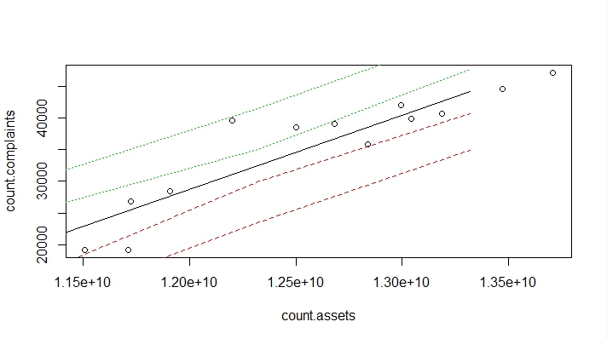
Q5. Effect of total assets on number of complaints
For this question, we applied linear regression as the data was continuous. The following graph shows the result of the model:
Intercept: -1.08e+05
Coefficient: 1.163e-05

Slide 13
MILESTONE 3 ANALYSIS

Slide 14
SUPPORT VECTOR MACHINE (SVM)

Slide 15
1.
Predicting a Company’s Response to a Consumer Complaint

Slide 16
Model Description
SPECIFIC DETAILS:
Library: kernlab
Sampling Rate: 75 (Training): 25 (Testing)
KERNELS USED:
Linear (vanilladot)
Gaussian (rbfdot)
Notes:
For Predictors: talk about data types, give examples of some of the levels, talk about levels (8) of outcome variable.
For Techniques: Talk about why we couldn’t apply the other techniques (data is not continuous so no linear regression etc.)

Slide 17
Results
Predicted/Actual | Closed | Closed with explanation | Closed with monetary relief | Closed with non-monetary relief | Closed with relief | Closed without relief | Untimely response
Closed | 0 | 0 | 0 | 0 | 0 | 0 | 0
Closed with explanation | 1142 | 35623 | 3065 | 6107 | 369 | 1292 | 0
Closed with monetary relief | 3 | 135 | 184 | 18 | 16 | 15 | 0
Closed with non-monetary relief | 0 | 0 | 0 | 0 | 0 | 0 | 0
Closed with relief | 0 | 0 | 0 | 0 | 0 | 0 | 0
Closed without relief | 0 | 0 | 0 | 0 | 0 | 0 | 0
Untimely response | 0 | 0 | 0 | 0 | 0 | 0 | 0
Kernel: Vanilladot (linear)
Approach: One vs One
Overall Accuracy: 0.7465

Slide 18
Results
Predicted/Actual | Closed | Closed with explanation | Closed with monetary relief | Closed with non-monetary relief | Closed with relief | Closed without relief | Untimely response
Closed | 0 | 0 | 0 | 0 | 0 | 0 | 0
Closed with explanation | 1133 | 35475 | 2965 | 6000 | 365 | 1291 | 0
Closed with monetary relief | 11 | 181 | 279 | 23 | 20 | 16 | 0
Closed with non-monetary relief | 1 | 102 | 5 | 102 | 0 | 0 | 0
Closed with relief | 0 | 0 | 0 | 0 | 0 | 0 | 0
Closed without relief | 0 | 0 | 0 | 0 | 0 | 0 | 0
Untimely response | 0 | 0 | 0 | 0 | 0 | 0 | 0
Kernel: Gaussian (non-linear)
Approach: one vs one
Overall Accuracy: 0.7475

Slide 19
2.
Likelihood of a Non-Disputed Complaint Feedback

Slide 20
Results
Predicted/Actual | No | Yes
No | 6238 | 1665
Yes | 0 | 0
Kernel: Vanilladot (linear)
Approach: One vs One
Overall Accuracy: 0.7893
Predicted/Actual | No | Yes
No | 6238 | 1665
Yes | 0 | 0
Kernel: Gaussian (non-linear)
Approach: one vs one
Overall Accuracy: 0.7893

Slide 21
3.
Predicting Medium of Receiving a Complaint

Slide 22
Results
Predicted/Actual | Email | Fax | Phone | Postal mail | Referral | Web
Email | 0 | 0 | 0 | 0 | 0 | 0
Fax | 0 | 0 | 0 | 0 | 0 | 0
Phone | 0 | 0 | 0 | 0 | 0 | 0
Postal mail | 0 | 0 | 0 | 0 | 0 | 0
Referral | 0 | 0 | 0 | 0 | 0 | 0
Web | 3 | 112 | 545 | 511 | 1451 | 5280
Kernel: Vanilladot (linear)
Approach: One vs One
Overall Accuracy: 0.6682

Slide 23
Results
Predicted/Actual | Email | Fax | Phone | Postal mail | Referral | Web
Email | 0 | 0 | 0 | 0 | 0 | 0
Fax | 0 | 0 | 0 | 0 | 0 | 0
Phone | 0 | 0 | 0 | 0 | 0 | 0
Postal mail | 0 | 0 | 0 | 0 | 0 | 0
Referral | 0 | 0 | 9 | 1 | 26 | 26
Web | 3 | 112 | 536 | 510 | 1425 | 5254
Kernel: Gaussian (non-linear)
Approach: one vs one
Overall Accuracy: 0.6682

Slide 24
4.
Predict Geographical Location Of a Complaint

Slide 25
Results
Predicted/Actual | Midwest | North East | South | West
Midwest | 0 | 0 | 0 | 0
North East | 0 | 0 | 0 | 0
South | 2444 | 3005 | 6334 | 4023
West | 0 | 0 | 0 | 0
Kernel: Vanilladot (linear)
Approach: One vs One
Overall Accuracy: 0.4007
Predicted/Actual | Midwest | North East | South | West
Midwest | 0 | 0 | 0 | 0
North East | 12 | 40 | 38 | 20
South | 2423 | 2962 | 6279 | 3981
West | 9 | 3 | 17 | 22
Kernel: Gaussian (non-linear)
Approach: one vs one
Overall Accuracy: 0.4012

Slide 26
5.
Effect Of Total Assets on #Complaints

Slide 27
Results
Predicted | Actual
30778.01 | 26875
39240.41 | 39075
38877.79 | 35865
38414.86 | 40700
Kernel: Vanilladot (linear)
Approach: One vs One
Correlation Coefficient: 0.9314
Predicted | Actual
30539.12 | 26875
33237.65 | 39075
33408.08 | 35865
33660.43 | 40700
Kernel: Gaussian (non-linear)
Approach: one vs one
Correlation Coefficient: 0.9556

Slide 28
Summary (Accuracy)
Kernel | Question 1 | Question 2 | Question 3 | Question 4
Linear | 0.7465 | 0.7893 | 0.6682 | 0.4007
Gaussian | 0.7475 | 0.7893 | 0.6682 | 0.4012

Slide 29
2. NEURAL NETWORKS

Slide 30
Q1.
Predicting a Company’s Response to a Consumer Complaint

Slide 31
Model Description
DATA SET DETAILS:
Predictors: Product, Region, Submitted Via
Outcome: Company Response to Consumer
Sampling Rate: 75 (Training): 25 (Testing)
Activation Function: Logistic
Hidden Layers: 1, 3, 5

Slide 32
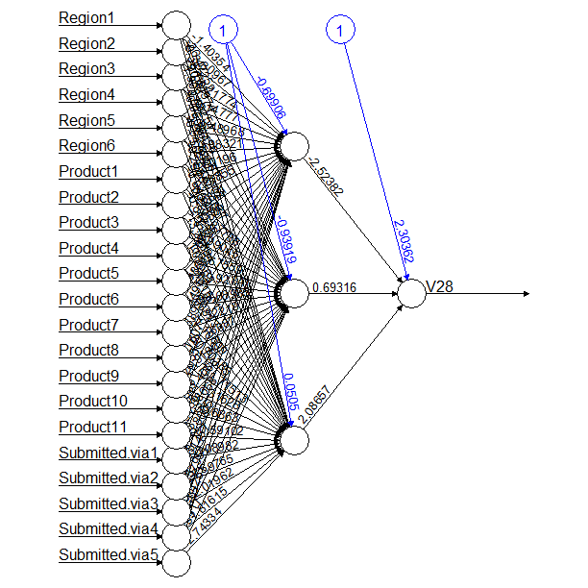
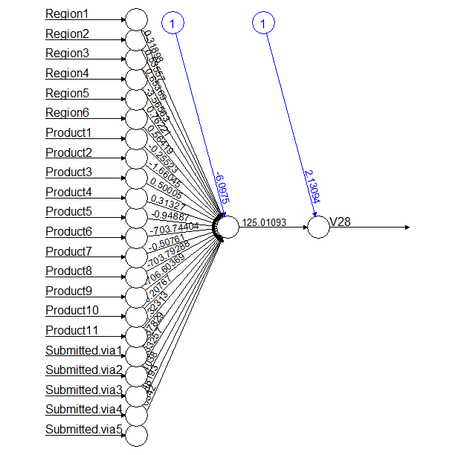
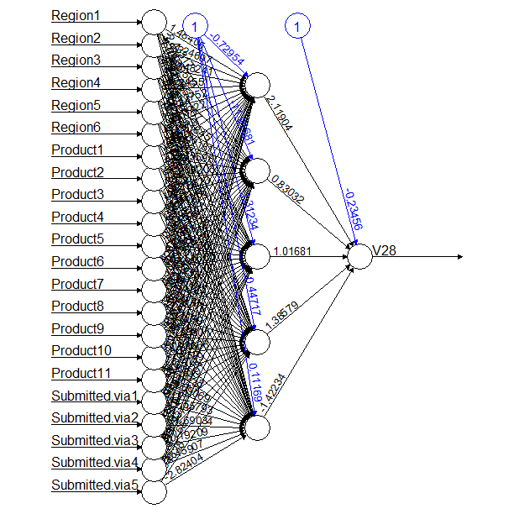
Results
Hidden = 3
Correlation = 0.00009
Hidden = 1
Correlation = 0.03
Hidden = 5
Correlation = 0.05
Note: We think that the correlation value is low for all the models because the model’s predicted value is continuous while the actual company response is categorical. Even though the value is low, highest correlation is observed in the model with 5 hidden layers.

Slide 33
Q2.
Likelihood of a Non-Disputed Complaint Feedback

Slide 34
Model Description
DATA SET DETAILS:
Predictors: Product, Region, Submitted Via
Outcome: Consumer disputed
Sampling Rate: 75 (Training): 25 (Testing)
Activation Function: Logistic
Hidden Layers: 1, 3, 5

Slide 35
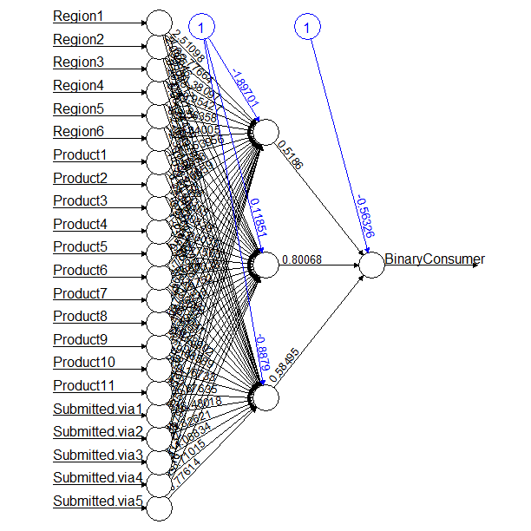
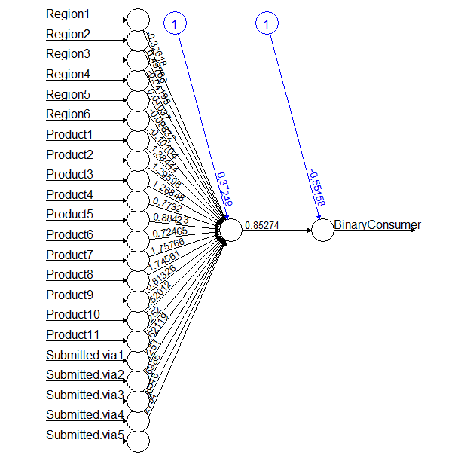
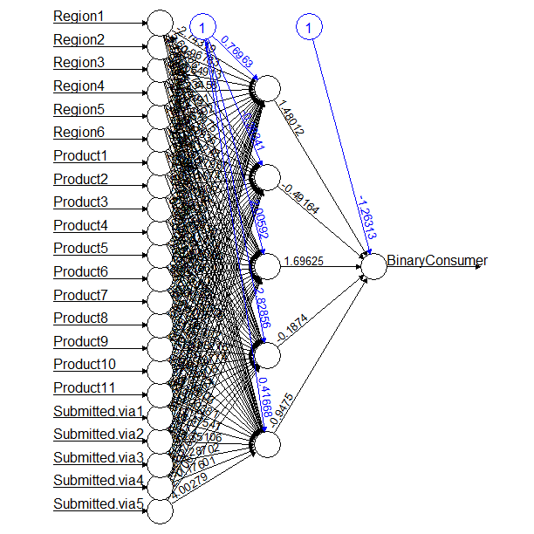
Results
Hidden = 3
Correlation = 0.04
Hidden = 1
Correlation = -0.04
Hidden = 5
Correlation = -0.04
Note: We think that the correlation value is low for all the models because the model’s predicted value is continuous while the actual value is categorical. Even though the value is low, highest correlation is observed in the model with 3 hidden layers.

Slide 36
Q3.
Predicting Medium of Receiving a Complaint

Slide 37
Model Description
DATA SET DETAILS:
Predictors: Product, Region
Outcome: Submitted Via
Sampling Rate: 75 (Training): 25 (Testing)
Activation Function: Logistic
Hidden Layers: 1, 3, 5

Slide 38
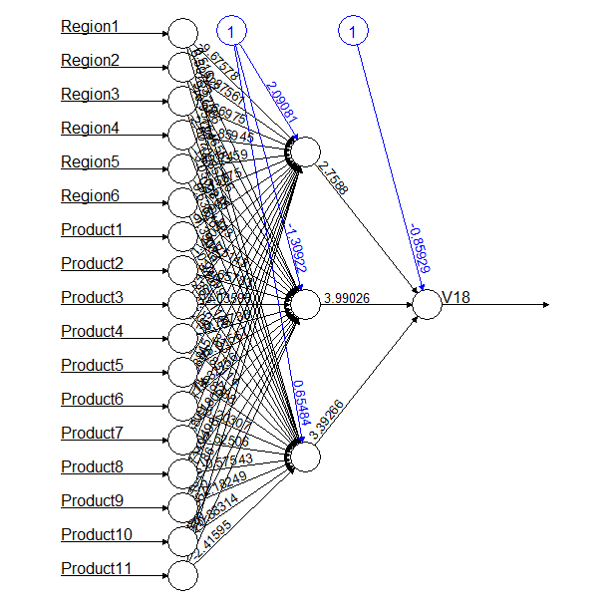
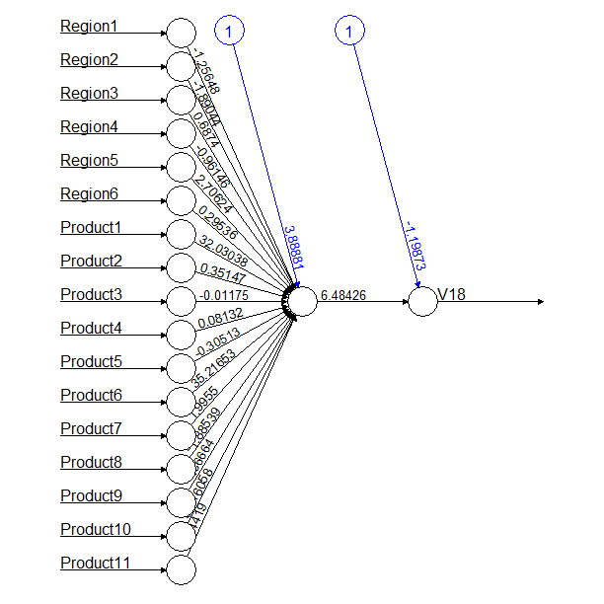
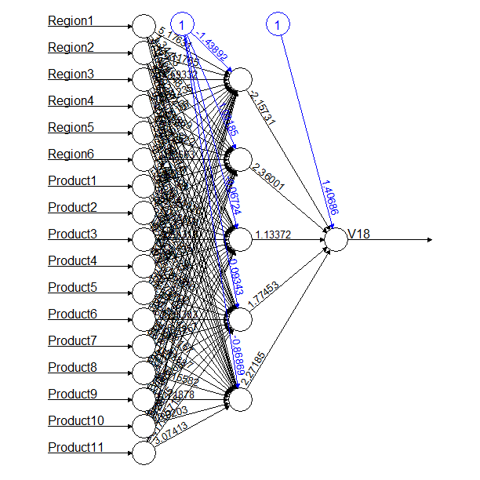
Results
Hidden = 3
Correlation = -0.00011
Hidden = 1
Correlation = -0.02
Hidden = 5
Correlation = 0.05
Note: We think that the correlation value is low for all the models because the model’s predicted value is continuous while the actual value is categorical. Even though the value is low, highest correlation is observed in the model with 5 hidden layers.

Slide 39
Q4.
Predict Geographical Location Of a Complaint

Slide 40
Model Description
DATA SET DETAILS:
Predictors: Product, Company, Submitted via
Outcome: Region
Sampling Rate: 75 (Training): 25 (Testing)
Activation Function: Logistic
Hidden Layers: 1, 3, 5

Slide 41
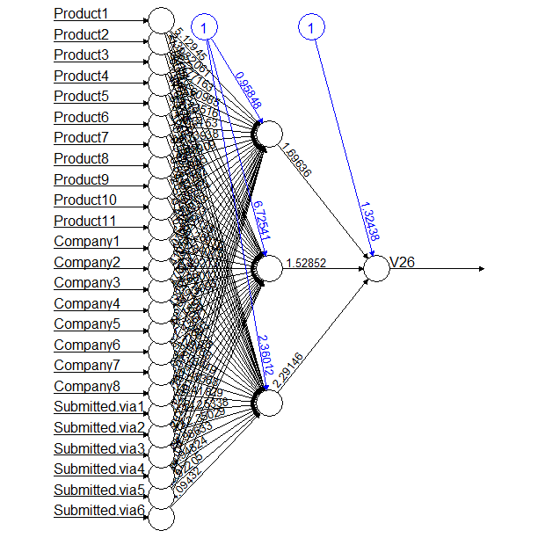
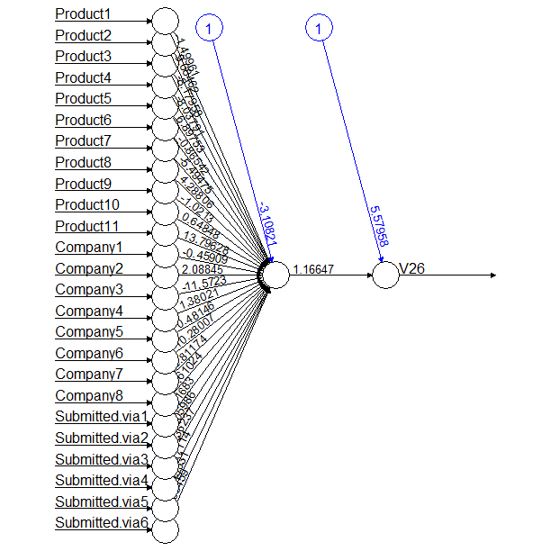
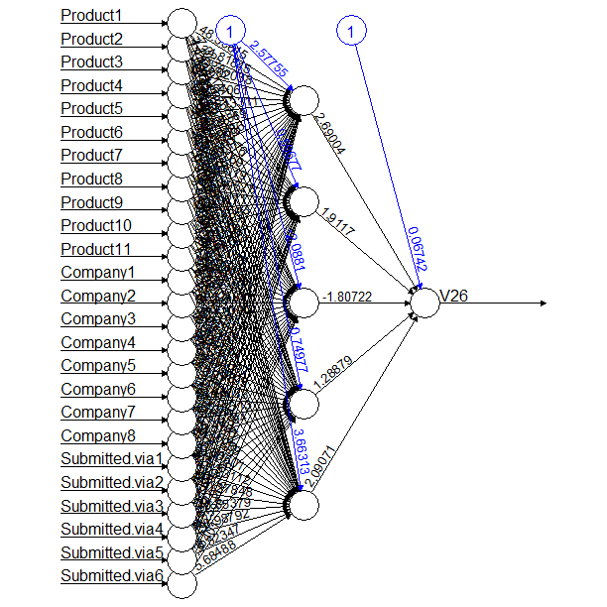
Results
Hidden = 3
Correlation = 0.10
Hidden = 1
Correlation = 0.33
Hidden = 5
Correlation = 0.09
Note: We think that the correlation value is low for all the models because the model’s predicted value is continuous while the actual value is categorical. Even though the value is low, highest correlation is observed in the model with 1 hidden layer.

Slide 42
Q5.
Effect Of Total Assets on #Complaints

Slide 43
Model Description
DATA SET DETAILS:
Predictors: Number of Complaints
Outcome: Total Assets
Sampling Rate: 75 (Training): 25 (Testing)
Activation Function: Logistic
Hidden Layers: 1, 3, 5

Slide 44
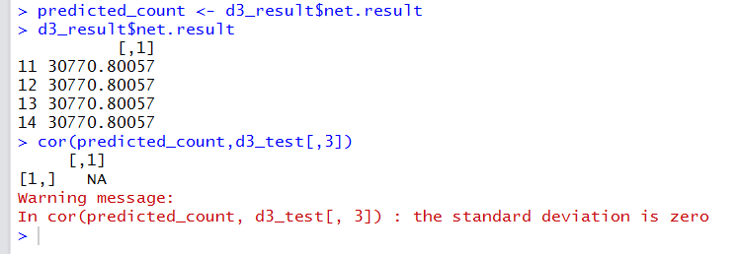
Results
For this question, since the number of records in the training and testing sets is very low (10 and 4 respectively), the values of Consumer_Count predicted by neuralnet () for the test set are all the same. Hence, no correlation value is generated as there is no standard deviation in the predicted values (shown below).
Hidden = 1, 3, 5
Correlation = NA

Slide 45
3. CLUSTERING

Slide 46
Q1.
Predicting a Company’s Response to a Consumer Complaint

Slide 47
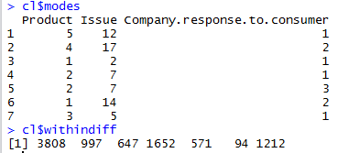
Technique 1: K MODES (klaR Package)
Columns used:
Product
Issue
Company Response to Consumer

Slide 48
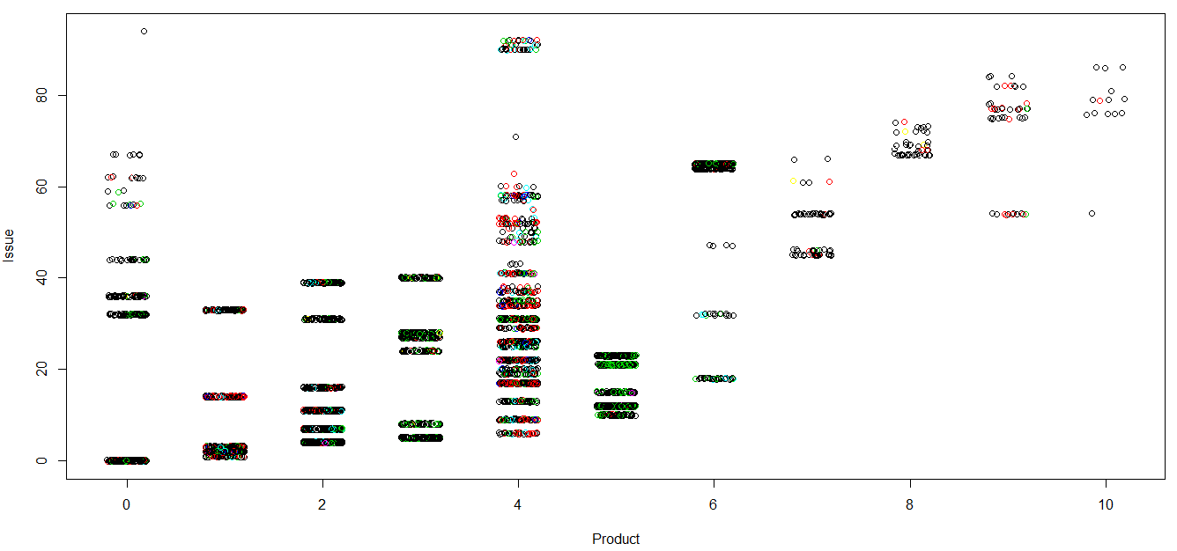
Scatter Plot (Colored on basis of Company Response)

Slide 49
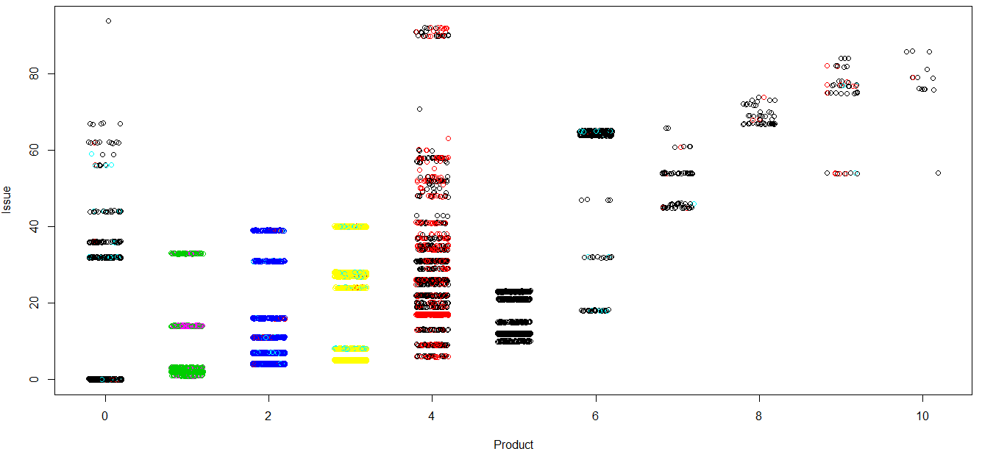
Scatter Plot (Colored on basis of Cluster)

Slide 50
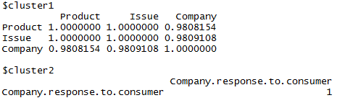
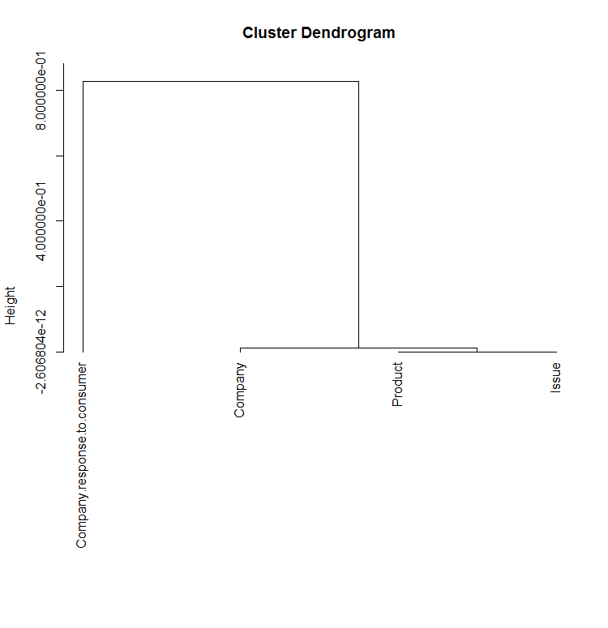
Technique 2: HIERARCHICAL CLUSTERING (ClustOfVar Package)

Slide 51
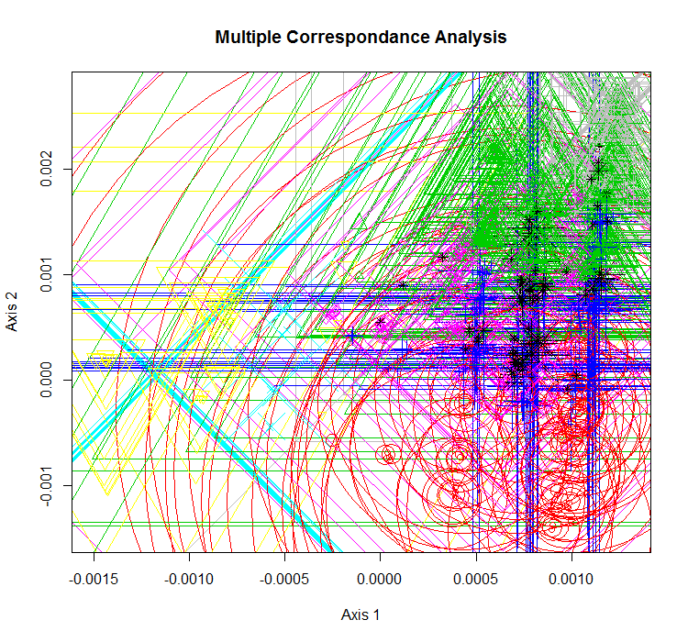
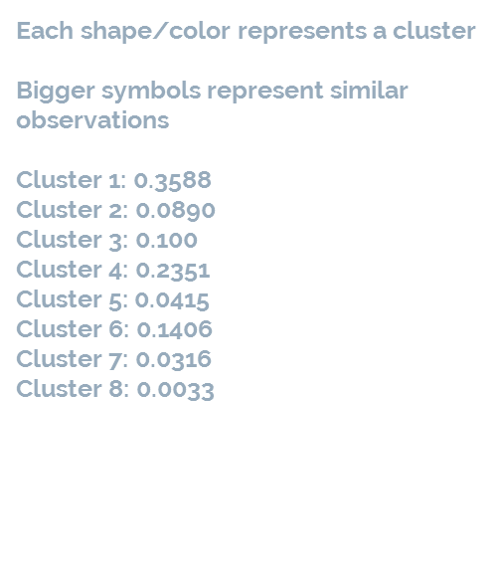
Technique 3: MIXTURE MODEL (Rmixmod Package)

Slide 52
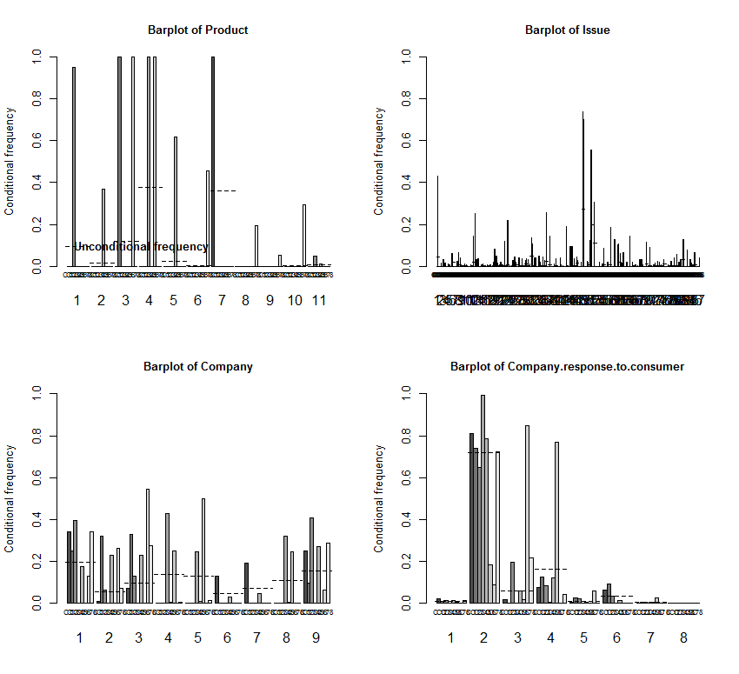
Mixture model plot

Slide 53
Q2.
Likelihood of a Non-Disputed Complaint Feedback

Slide 54
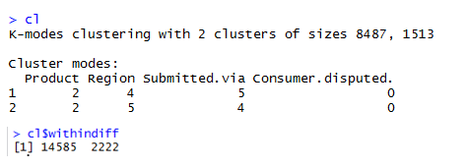
Technique 1: K MODES (klaR Package)
Columns used:
Product
Region
Submitted.Via
Consumer.Disputed.

Slide 55
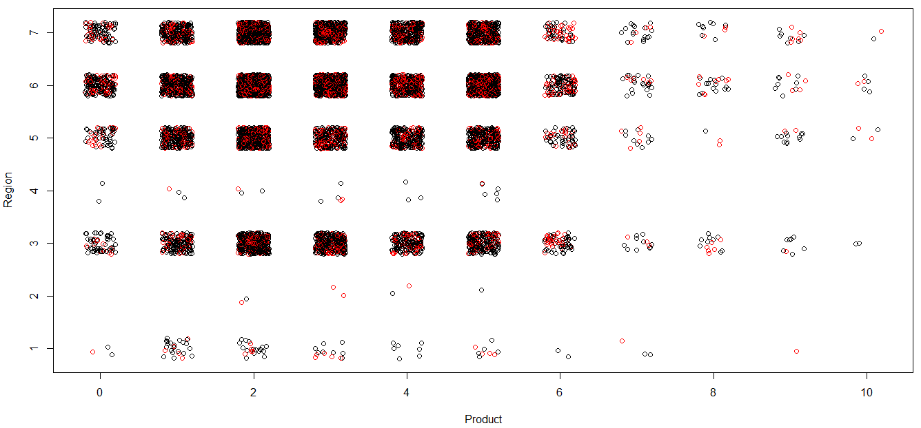
Scatter Plot (Colored on basis of Disputed or Not)

Slide 56
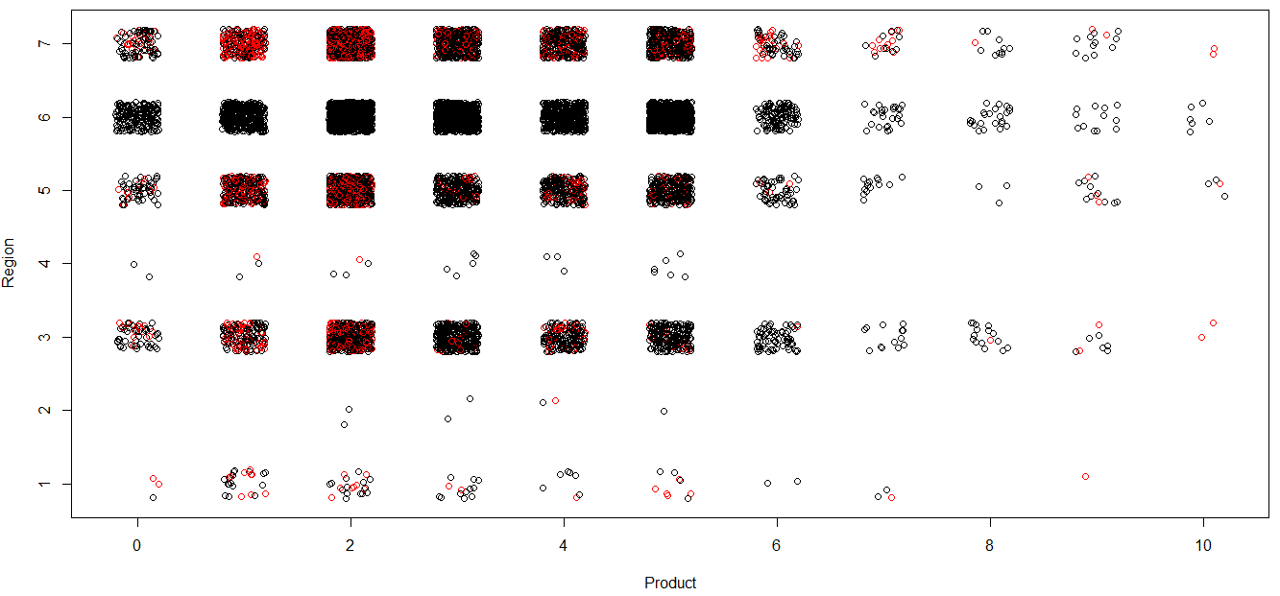
Scatter Plot (Colored on basis of Cluster)

Slide 57
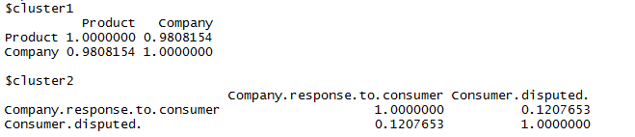
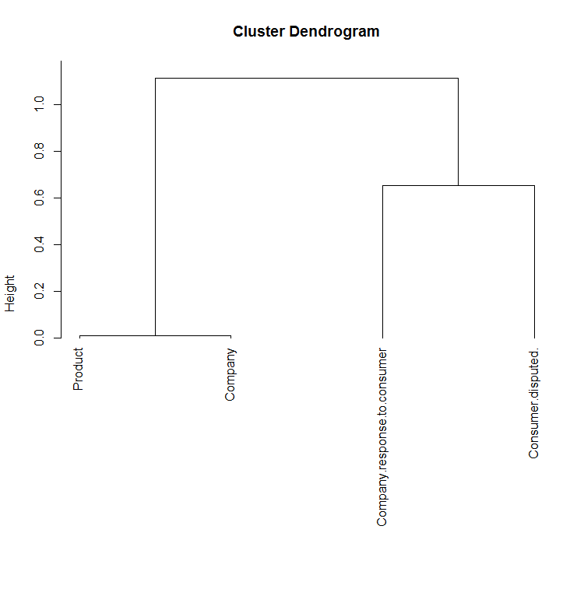
Technique 2: HIERARCHICAL CLUSTERING (ClustOfVar Package)

Slide 58
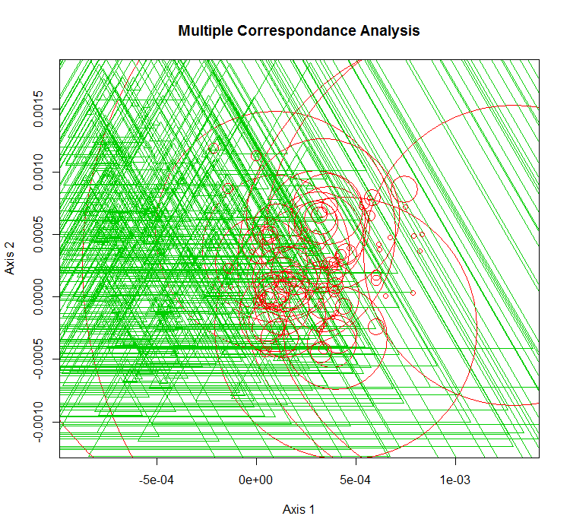

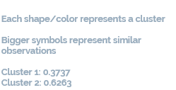
Technique 3: MIXTURE MODEL (Rmixmod Package)

Slide 59
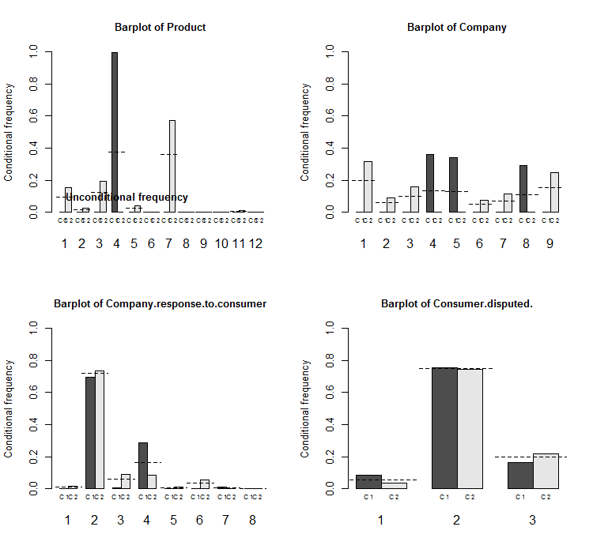
Mixture model plot

Slide 60
Q3.
Predicting Medium of Receiving a Complaint

Slide 61
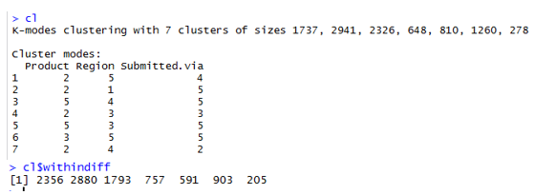
Technique 1: K MODES (klaR Package)
Columns used:
Product
Region
Submitted.Via

Slide 62
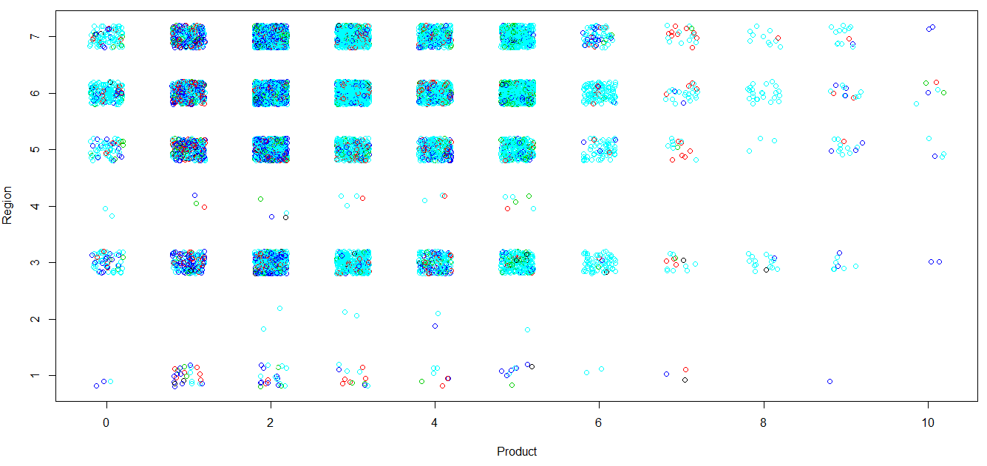
Scatter Plot (Colored on basis of Disputed or Not)

Slide 63
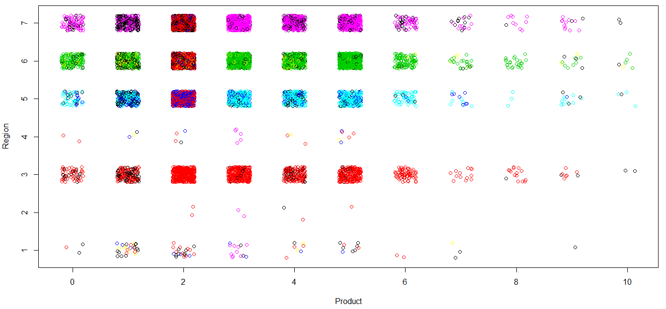
Scatter Plot (Colored on basis of Cluster)

Slide 64
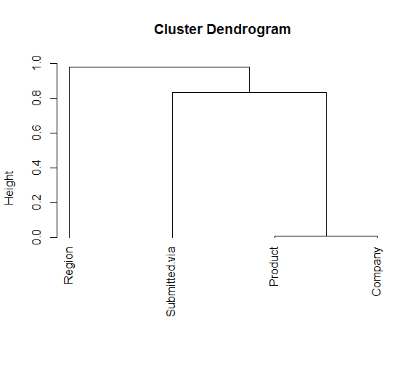
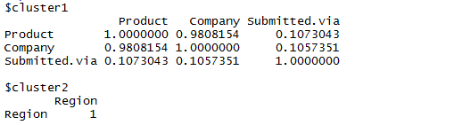
Technique 2: HIERARCHICAL CLUSTERING (ClustOfVar Package)

Slide 65
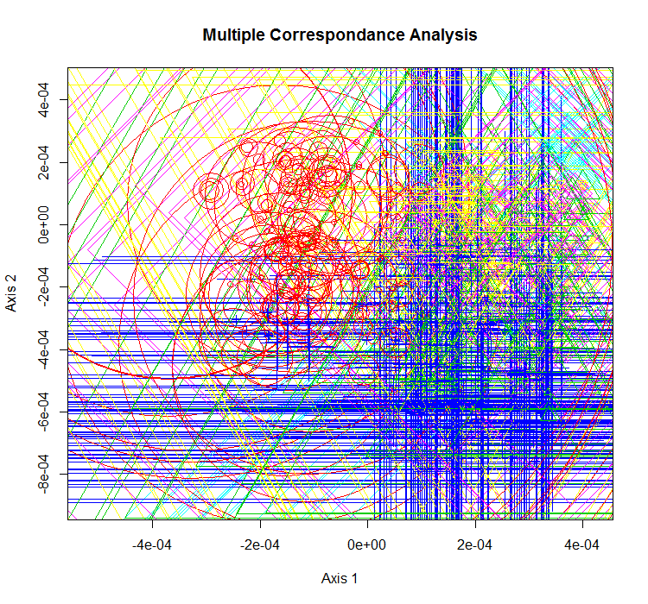
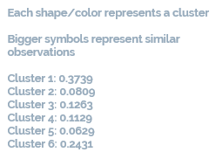
Technique 3: MIXTURE MODEL (Rmixmod Package)

Slide 66
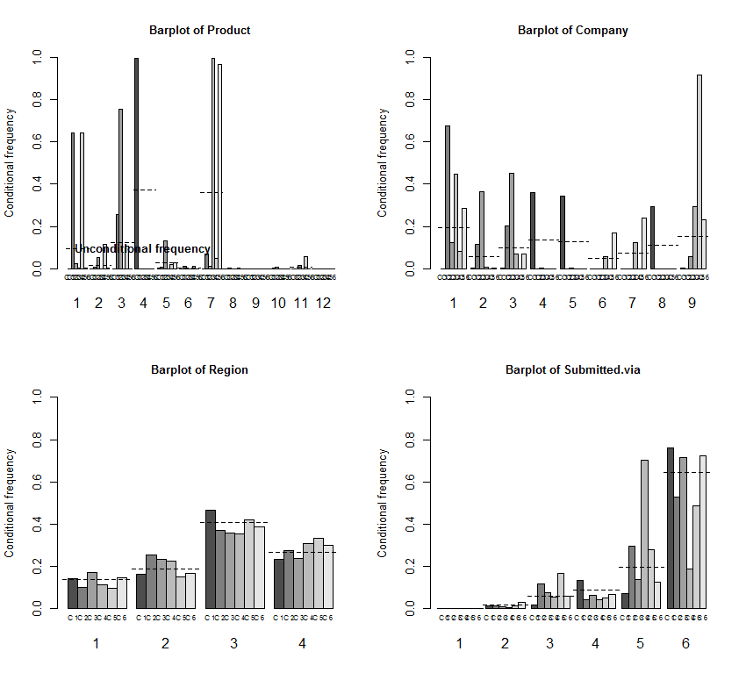
Mixture model plot

Slide 67
Q4.
Predict Geographical Location Of a Complaint

Slide 68
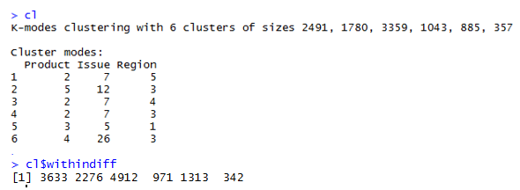
Technique 1: K MODES (klaR Package)
Columns used:
Product
Issue
Region

Slide 69
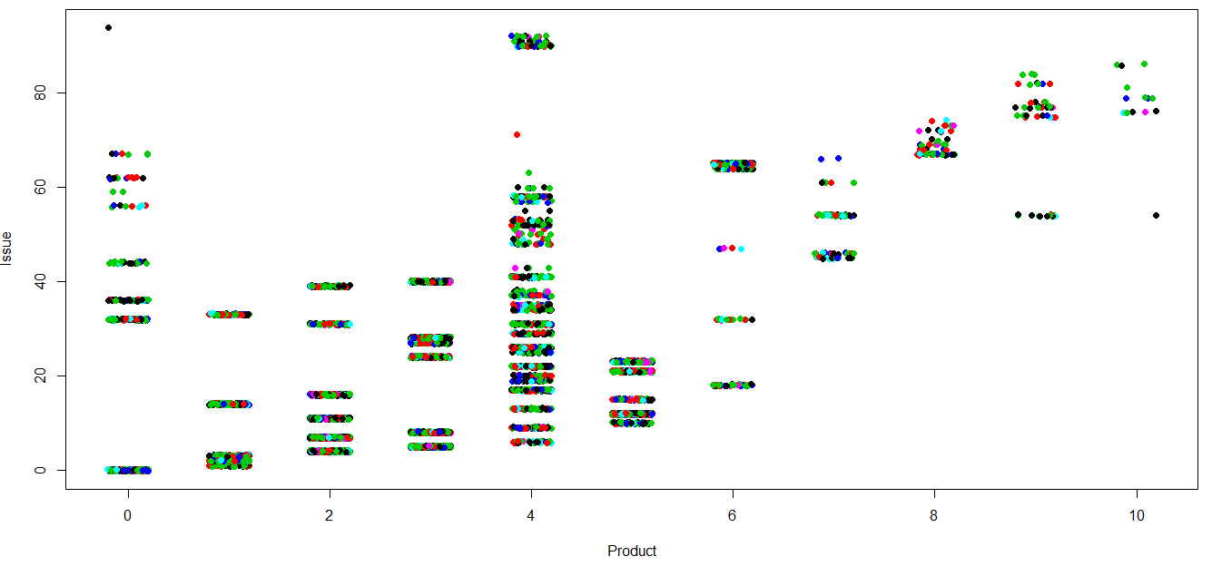
Scatter Plot (Colored on basis of Disputed or Not)

Slide 70
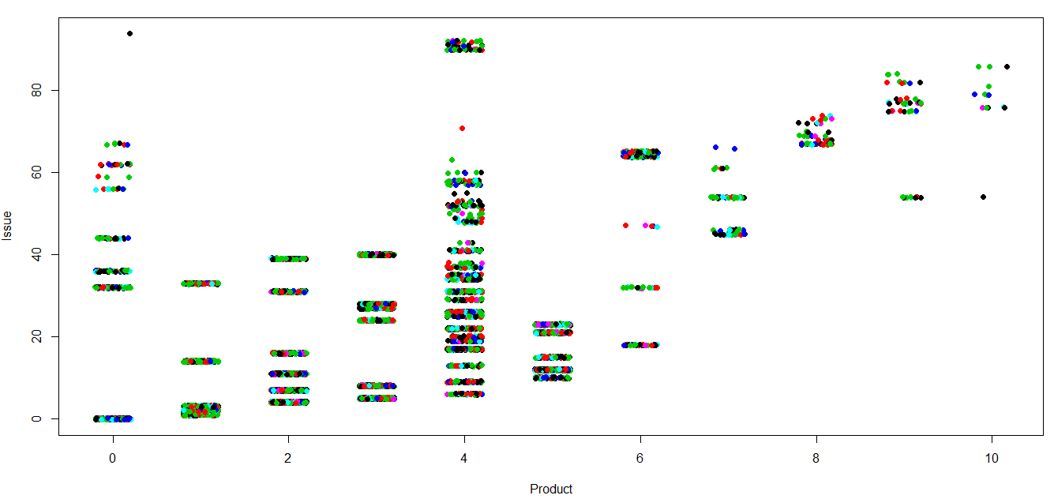
Scatter Plot (Colored on basis of Cluster)

Slide 71
Technique 2: HIERARCHICAL CLUSTERING (ClustOfVar Package)

Slide 72
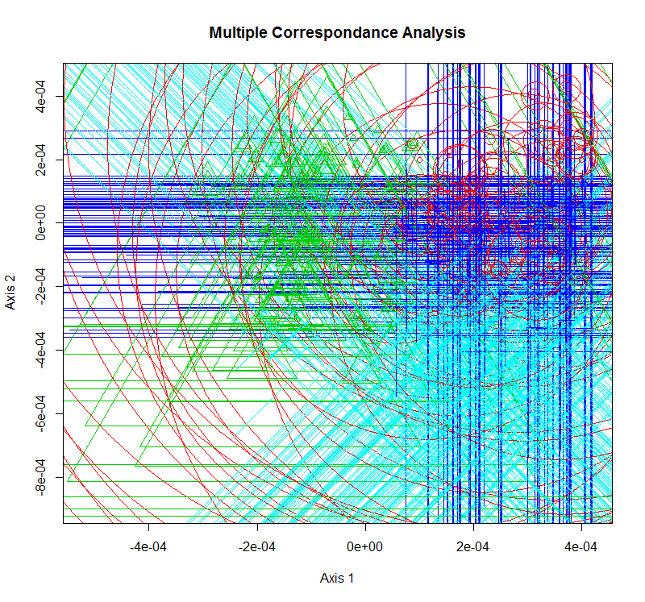
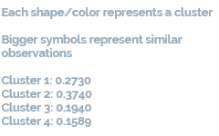
Technique 3: MIXTURE MODEL (Rmixmod Package)

Slide 73
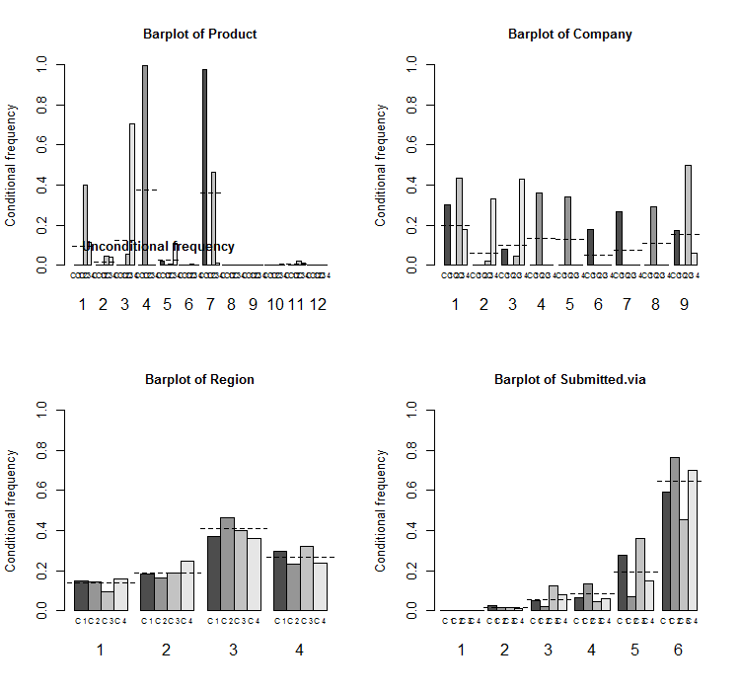
Mixture model plot

Slide 74
Q5.
Effect Of Total Assets on #Complaints

Slide 75
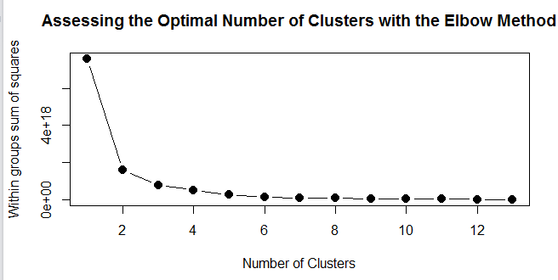
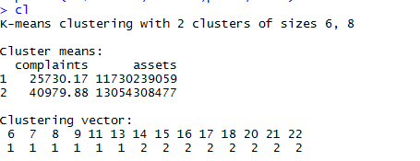
Technique 1: K MEANS (statistics Package)
Columns used:
Count.of.Complaints
Sum.of.Assets

Slide 76
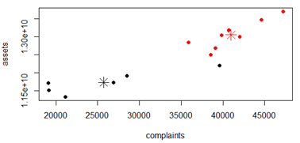

Scatter Plot with Centres
Accuracy:

Slide 77
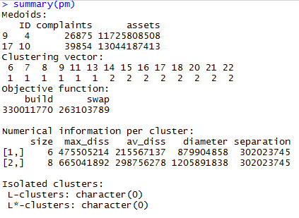
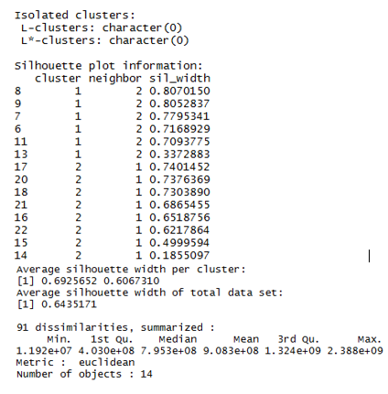
Technique 2: K MEDOIDS (cluster Package)
Columns used:
Count.of.Complaints
Sum.of.Assets

Slide 78

Scatter Plot with Centres

Slide 79

Technique 3: SPECTRAL CLUSTERING (kernlab Package)
Columns used:
Count.of.Complaints
Sum.of.Assets

Slide 80

Scatter Plot with Centres

Slide 81

Technique 4: MIXTURE CLUSTERING (mclust Package)
Columns used:
Count.of.Complaints
Sum.of.Assets

Slide 82

Scatter Plot with Centres

Slide 83
CROSS VALIDATION

Slide 84
Model Description
SPECIFIC DETAILS:
Library: caret
Classification/Regression Techniques compared: Random Forest, Linear Regression, Support Vector Machine, Neural Networks
CROSS VALIDATION TECHNIQUES:
K-Fold
Repeated K-Fold
Bootstrap
Leave-One-Out (LOOCV)
Notes:
For Predictors: talk about data types, give examples of some of the levels, talk about levels (8) of outcome variable.
For Techniques: Talk about why we couldn’t apply the other techniques (data is not continuous so no linear regression etc.)

Slide 85
1.
Predicting a Company’s Response to a Consumer Complaint

Slide 86
K-Fold
Accuracy:
Model | Minimum | 1st Quantile | Median | Mean | 3rd Quantile | Maximum
NN | 0.748 | 0.7505 | 0.752 | 0.7525 | 0.7544 | 0.7579
RF | 0.7492 | 0.7508 | 0.752 | 0.7519 | 0.7528 | 0.7544
SVM | 0.7468 | 0.7508 | 0.752 | 0.7522 | 0.7542 | 0.7575
Kappa:
Model | Minimum | 1st Quantile | Median | Mean | 3rd Quantile | Maximum
NN | 0 | 0.01965 | 0.0318 | 0.03111 | 0.04378 | 0.06049
RF | 0 | 0 | 0 | 0 | 0 | 0
SVM | -0.007934 | 0.008702 | 0.01492 | 0.0143 | 0.02126 | 0.04005

Slide 87
Repeated K-Fold
Accuracy:
Model | Minimum | 1st Quantile | Median | Mean | 3rd Quantile | Maximum
NN | 0.748 | 0.7505 | 0.752 | 0.7525 | 0.7544 | 0.7579
RF | 0.7492 | 0.7508 | 0.752 | 0.7519 | 0.7528 | 0.7544
SVM | 0.7468 | 0.7508 | 0.752 | 0.7522 | 0.7542 | 0.7575
Kappa:
Model | Minimum | 1st Quantile | Median | Mean | 3rd Quantile | Maximum
NN | 0 | 0.01965 | 0.0318 | 0.03111 | 0.04378 | 0.06049
RF | 0 | 0 | 0 | 0 | 0 | 0
SVM | -0.007934 | 0.008702 | 0.01492 | 0.0143 | 0.02126 | 0.04005

Slide 88
Bootstrap
Accuracy:
Model | Minimum | 1st Quantile | Median | Mean | 3rd Quantile | Maximum
NN | 0.7387 | 0.7442 | 0.7492 | 0.7503 | 0.7544 | 0.7651
RF | 0.7473 | 0.7541 | 0.755 | 0.7558 | 0.7574 | 0.7669
SVM | 0.7274 | 0.7504 | 0.7556 | 0.7528 | 0.7593 | 0.7619

Slide 89
2.
Likelihood of a Non-Disputed Complaint Feedback

Slide 90
K-Fold
Accuracy:
Model | Minimum | 1st Quantile | Median | Mean | 3rd Quantile | Maximum
NN | 0.7883 | 0.7883 | 0.7896 | 0.7892 | 0.7896 | 0.7899
RF | 0.7883 | 0.7883 | 0.7896 | 0.7892 | 0.7896 | 0.7899
SVM | 0.7864 | 0.7883 | 0.7896 | 0.7891 | 0.7896 | 0.7899
Kappa:
Model | Minimum | 1st Quantile | Median | Mean | 3rd Quantile | Maximum
NN | 0 | 0 | 0 | 0 | 0 | 0
RF | 0 | 0 | 0 | 0 | 0 | 0
SVM | -0.006274 | 0 | 0 | -0.0002091 | 0 | 0

Slide 91
Repeated K-Fold
Accuracy:
Model | Minimum | 1st Quantile | Median | Mean | 3rd Quantile | Maximum
NN | 0.7883 | 0.7883 | 0.7896 | 0.7892 | 0.7896 | 0.7899
RF | 0.7883 | 0.7883 | 0.7896 | 0.7892 | 0.7896 | 0.7899
SVM | 0.7864 | 0.7883 | 0.7896 | 0.7891 | 0.7896 | 0.7899
Kappa:
Model | Minimum | 1st Quantile | Median | Mean | 3rd Quantile | Maximum
NN | 0 | 0 | 0 | 0 | 0 | 0
RF | 0 | 0 | 0 | 0 | 0 | 0
SVM | -0.006274 | 0 | 0 | -0.0002091 | 0 | 0

Slide 92
Bootstrap
Accuracy:
Model | Minimum | 1st Quantile | Median | Mean | 3rd Quantile | Maximum
NN | 0.7769 | 0.7819 | 0.7859 | 0.7883 | 0.7961 | 0.8002
RF | 0.7687 | 0.7821 | 0.7861 | 0.787 | 0.7899 | 0.8033
SVM | 0.7818 | 0.7871 | 0.7911 | 0.7902 | 0.7932 | 0.7991

Slide 93
3.
Predicting Medium of Receiving a Complaint

Slide 94
K-Fold
Accuracy:
Model | Minimum | 1st Quantile | Median | Mean | 3rd Quantile | Maximum
NN | 0.6572 | 0.6663 | 0.6696 | 0.6693 | 0.6742 | 0.6777
RF | 0.6667 | 0.6677 | 0.6677 | 0.6679 | 0.6682 | 0.6693
SVM | 0.6635 | 0.6661 | 0.6682 | 0.6679 | 0.6692 | 0.6714

Slide 95
Repeated K-Fold
Accuracy:
Model | Minimum | 1st Quantile | Median | Mean | 3rd Quantile | Maximum
NN | 0.6483 | 0.6667 | 0.6688 | 0.6693 | 0.6744 | 0.6772
RF | 0.6646 | 0.6677 | 0.6682 | 0.6679 | 0.6682 | 0.6693
SVM | 0.6566 | 0.6663 | 0.6682 | 0.6676 | 0.6704 | 0.6741

Slide 96
Bootstrap
Accuracy:
Model | Minimum | 1st Quantile | Median | Mean | 3rd Quantile | Maximum
NN | 0.6556 | 0.6657 | 0.671 | 0.6704 | 0.6765 | 0.6843
RF | 0.6571 | 0.6647 | 0.6687 | 0.6683 | 0.6715 | 0.6776
SVM | 0.1859 | 0.6639 | 0.6685 | 0.622 | 0.6732 | 0.6872

Slide 97
4.
Predict Geographical Location Of a Complaint

Slide 98
K-Fold
Accuracy:
Model | Minimum | 1st Quantile | Median | Mean | 3rd Quantile | Maximum
NN | 0.3965245 | 0.3987342 | 0.399684 | 0.4004771 | 0.4005523 | 0.4104596
RF | 0.399684 | 0.3998421 | 0.4003165 | 0.4006327 | 0.4012638 | 0.4018987
SVM | 0.3965245 | 0.4003165 | 0.4003165 | 0.4003165 | 0.4012638 | 0.4018987
Kappa:
Model | Minimum | 1st Quantile | Median | Mean | 3rd Quantile | Maximum
NN | 0 | 0 | 0.004567353 | 0.005955571 | 0.006755079 | 0.02833465
RF | 0 | 0 | 0 | 0 | 0 | 0
SVM | -0.003323582 | 0 | 0 | -9.84875E-06 | 0 | 0.003225095

Slide 99
Repeated K-Fold
Accuracy:
Model | Minimum | 1st Quantile | Median | Mean | 3rd Quantile | Maximum
NN | 0.3933649 | 0.3959734 | 0.399684 | 0.4000545 | 0.4033217 | 0.4082278
RF | 0.399684 | 0.4003165 | 0.4004737 | 0.4006326 | 0.4012638 | 0.4018987
SVM | 0.399684 | 0.4003165 | 0.4003165 | 0.4005797 | 0.4012638 | 0.4012638

Slide 100
Bootstrap
Accuracy:
Model | Minimum | 1st Quantile | Median | Mean | 3rd Quantile | Maximum
NN | 0.3978541 | 0.3984102 | 0.4040858 | 0.4034615 | 0.4074712 | 0.4096802
RF | 0.3820612 | 0.391531 | 0.3986125 | 0.3982897 | 0.4047227 | 0.4119429
SVM | 0.3810137 | 0.3910716 | 0.3963272 | 0.3951147 | 0.4016323 | 0.40625

Slide 101
5.
Effect Of Total Assets on #Complaints

Slide 102
K-Fold
Root Mean Square Error:
Model | Minimum | 1st Quantile | Median | Mean | 3rd Quantile | Maximum
NN | 19130 | 27270 | 33970 | 33370 | 41530 | 44620
LR | 61.23 | 2094 | 3320 | 2924 | 4174 | 4990
SVM | 1.107 | 2659 | 4077 | 4280 | 6065 | 8630
R-Squared:
Model | Minimum | 1st Quantile | Median | Mean | 3rd Quantile | Maximum
NN | NA | NA | NA | NaN | NA | NA
LR | 1 | 1 | 1 | 1 | 1 | 1
SVM | 1 | 1 | 1 | 1 | 1 | 1

Slide 103
Repeated K-Fold
Root Mean Square Error:
Model | Minimum | 1st Quantile | Median | Mean | 3rd Quantile | Maximum
NN | 19130 | 32480 | 39060 | 35920 | 40490 | 47200
LR | 61.23 | 2170 | 3272 | 3155 | 4277 | 5765
SVM | 40.44 | 1939 | 4481 | 4111 | 5726 | 10960
R-Squared:
Model | Minimum | 1st Quantile | Median | Mean | 3rd Quantile | Maximum
NN | NA | NA | NA | NaN | NA | NA
LR | 1 | 1 | 1 | 1 | 1 | 1
SVM | 1 | 1 | 1 | 1 | 1 | 1

Slide 104
Bootstrap
Root Mean Square Error:
Model | Minimum | 1st Quantile | Median | Mean | 3rd Quantile | Maximum
NN | 28250 | 34570 | 35090 | 35020 | 36850 | 40710
RF | 2629 | 2910 | 3433 | 3567 | 4089 | 5309
SVM | 2305 | 3218 | 3750 | 4003 | 4417 | 7410
R-Square:
Model | Minimum | 1st Quantile | Median | Mean | 3rd Quantile | Maximum
NN | NA | NA | NA | NaN | NA | NA
LM | 0.7435 | 0.8467 | 0.9092 | 0.8916 | 0.9446 | 0.9743
SVM | 0.8582 | 0.8609 | 0.888 | 0.897 | 0.9165 | 0.9872

Slide 105
Summary (Accuracy)
CV Method | Model | Question 1 | Question 2 | Question 3 | Question 4
K-Fold | NN | 0.7472 | 0.7896 | 0.6696 | 0.399684
 | RF | 0.7457 | 0.7896 | 0.6677 | 0.4003165
 | SVM | 0.7466 | 0.7896 | 0.6682 | 0.4003165
Repeated K-Fold | NN | 0.752 Kappa highest) | 0.7896 | 0.6688 | 0.399684
 | RF | 0.752 | 0.7896 | 0.6682 | 0.4004737
 | SVM | 0.752 | 0.7896 | 0.6682 | 0.4003165
Bootstrap | NN | 0.7492 | 0.7859 | 0.671 | 0.4040858
 | RF | 0.755 | 0.7861 | 0.6687 | 0.3986125
 | SVM | 0.7556 | 0.7911 | 0.6685 | 0.3963272

